Slide 1

P2 Chapter 6 :: Trigonometry
jfrost@tiffin.kingston.sch.uk
www.drfrostmaths.com
@DrFrostMaths
Last modified: 29th September 2025

Slide 2
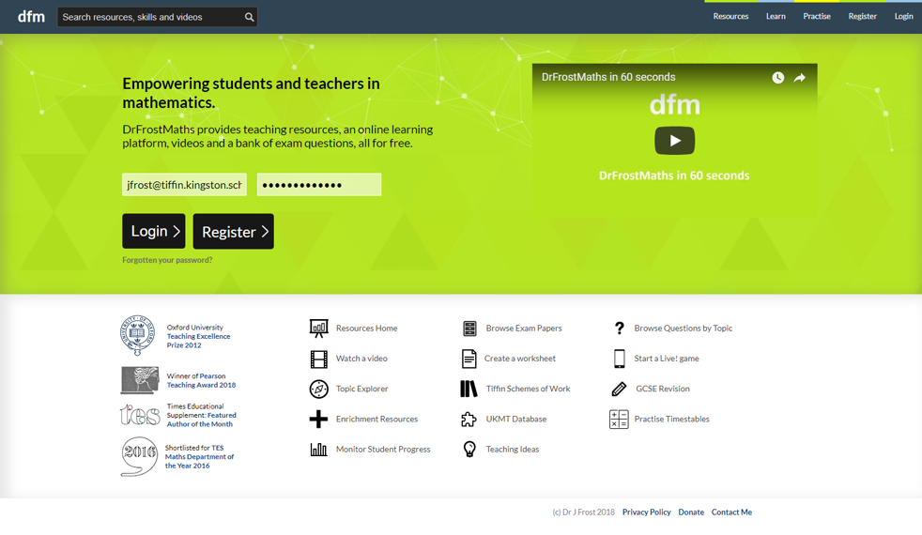



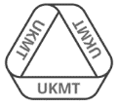
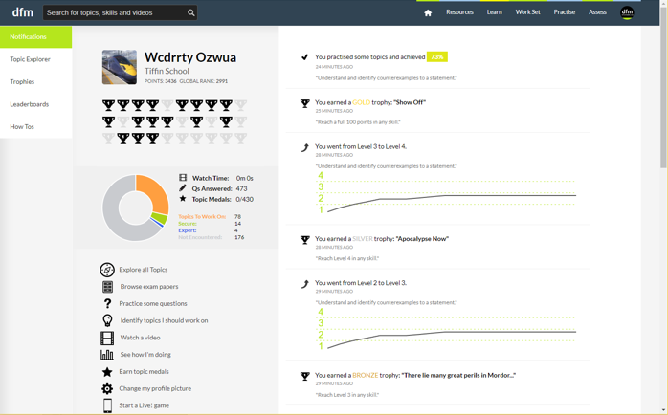
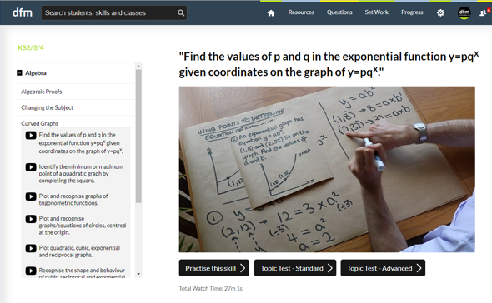
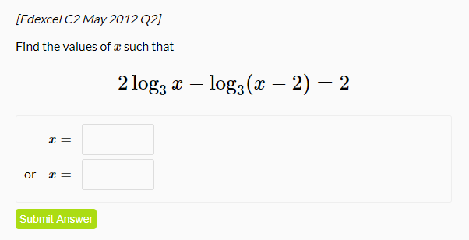
www.drfrostmaths.com
Everything is completely free.
Why not register?
Register now to interactively practise questions on this topic, including past paper questions and extension questions (including MAT + UKMT).
Teachers: you can create student accounts (or students can register themselves), to set work, monitor progress and even create worksheets.
With questions by:
Dashboard with points, trophies, notifications and student progress.
Questions organised by topic, difficulty and past paper.
Teaching videos with topic tests to check understanding.

Slide 3
Chapter Overview
This chapter is very similar to the trigonometry chapters in Year 1. The only difference is that new trig functions: $$sec, cosec$$ and $$cot$$, are introduced.
1:: Understanding $$sec, cosec, tan$$ and draw their graphs.
2:: ‘Solvey’ questions.
“Solve, for $$0≤x<2π$$, the equation
$$2cosec^{2}x+\cot{x}=5$$
giving your solutions to 3sf.”
“Draw a graph of $$y=cosec x$$ for $$0≤x<2π$$.”
4:: Inverse trig functions and their domains/ranges.
3:: ‘Provey’ questions.
“Prove that
$$\sec{x}−\cos{x}≡\sin{x}\tan{x}$$
“Show that, when $$θ$$ is small,
$$\sin{5θ}+\tan{2θ}−cos2θ≈2θ^{2}+7θ−1$$.”
Teacher Note: There is no change in this chapter relative to the old pre-2017 syllabus.

Slide 4
A new member of the trig family…
$$\cos\left(x\right)$$
Original and best. Like the ‘Classic Cola’ of trig functions*.
$$\cos^{2}\left(x\right)={\left(\cos{x}\right)}^{2}$$
The latter form is particularly useful for differentiation (see Chp9)
Be careful: the -1 here doesn’t mean a power of -1 UNLIKE $$\cos^{2}{x}$$ above. This is an unfortunate historical accident. $$arccos$$ is an alternative notation we’ll see later this chapter.
$$\cos^{−1}\left(x\right) or arccos⁡(x)$$
$$\sec\left(x\right)=\frac{1}{\cos\left(x\right)}$$
We have a convenient way of representing the reciprocal of the trig functions.
* Actually, I’ll contradict this in the ‘Just For Your Interest’ slides coming up soon.

Slide 5
Reciprocal Trigonometric Functions
!
$$\sec\left(x\right)=\frac{1}{\cos\left(x\right)}$$
Short for “secant”
Pronounced “sehk” in shortened form or “sea-Kant” in full.
$$\operatorname{cosec}\left(x\right)=\frac{1}{\sin\left(x\right)}$$
Short for “cosecant”
$$\cot\left(x\right)=\frac{1}{\tan\left(x\right)} or \frac{\cos\left(x\right)}{\sin\left(x\right)}$$
Short for “cotangent”
In shortened form, rhymes with “pot”.
Fro Tip: To remember these, look at the 3rd letter: $$sec$$’s 3rd is ‘c’ so it’s 1 over cos.
We typically use this version instead of $$\frac{1}{tan x}$$ when doing proof questions.

Slide 6


Just for your interest…
Is ‘tangent’ ($$tan$$) in trigonometry related to the ‘tangent’ of a circle?
A tangent is a trigonometric function (which inputs an angle and gives you the ratio between the opposite and adjacent sides of a right-angled triangle), but also a line which touches a circle. Are they related?
A common myth is that $$sin$$, $$cos$$ and $$tan$$ are the ‘core’ trigonometric functions.
Actually, they’re $$sin, tan$$ and $$sec$$!
?
?
?
tangent
A tangent is a line which touches the circle. We’re interested in the length just between the touching point and where it meets the secant.
$$\tan{θ}=\frac{opp}{adj}$$
?
Just as ‘radius’ can refer either to the line itself or its length, we have names for other special lines, which can also refer to their lengths:
$$secant$$
$$tangent$$
$$sine$$
A secant (shortened to ‘sec’) is a line which cuts the circle. In a trig setting, we’re interested in the length from the circle centre to where it meets the tangent.
$$θ$$
Sine (sort of) comes from the word for ‘bowstring’. It refers to half the line if we doubled up the arc and connected the two ends.
$$radius$$

Slide 7
Suppose we let the radius of the sector be 1. Then if we define $$\sin{θ}=\frac{opp}{hyp}$$ and $$\tan{θ}=\frac{opp}{adj}$$ and $$\sec{θ}=\frac{hyp}{adj}$$ then this conveniently gives us:
$$\sin{θ}=\frac{a}{1}=a \tan{θ}=\frac{b}{1}=b$$$$\sec{θ}=\frac{c}{1}=c$$
i.e. $$\sin{θ}$$, $$\tan{θ}$$ and $$\sec{θ}$$ actually give us the lengths of the sine, tangent and secant respectively.
$$c$$
$$1$$
$$secant$$
$$tangent$$
$$b$$
$$sine$$
$$a$$
$$θ$$
$$radius$$
$$1$$
And hence $$\tan{θ}$$ and the length of the ‘tangent’ are clearly linked!
“So if $$sin$$, $$tan$$ and $$sec$$ are the ‘core’ trigonometric functions, where does $$cos$$ come into the fray?”
“cosine” ($$cos$$), “cotangent” ($$cot$$) and “cosecant” ($$cosec$$) are the ‘complementary’ trig functions. Complementary angles add to $$90°$$.
The two smaller angles in a right-angled triangle are clearly complementary.
The complementary sine (cosine) of an angle is by definition the sine of the complementary angle, e.g. $$\cos\left(40°\right)=\sin\left(50°\right)$$. Thus:
$$\cos\left(θ\right)=\sin\left(90°−θ\right) \operatorname{cosec}\left(θ\right)=\sec\left(90°−θ\right)$$$$\cot\left(θ\right)=\tan\left(90°−θ\right)$$
$$40°$$
$$50°$$
(A very common misconception is that the definition of $$\cot{θ}≡\frac{1}{\tan{θ}}$$. While this identity is true, this is not the definition of $$\cot{θ}$$, and is a consequence of the adjacent and opposite swapping when we switch to the complementary angle.)

Slide 8
Calculations
You have a calculator in A Level exams, but won’t however in STEP, etc. It’s good however to know how to calculate certain values yourself if needed.
?
$$\cot{\frac{π}{4}}=\frac{1}{\tan{\frac{π}{4}}}=\frac{1}{1}=1$$sec𝜋4=𝟏𝐜𝐨𝐬𝝅𝟒=𝟏𝟏𝟐=𝟐
cosec𝜋3=𝟏𝐬𝐢𝐧𝝅𝟑=𝟐𝟑
cot𝜋6=𝟑
$$\operatorname{cosec}{\frac{5π}{6}}=\operatorname{cosec}{\frac{π}{6}}=2$$
cot𝜋3=𝟏𝟑
sec𝜋6=𝟐𝟑
$$\operatorname{cosec}{\frac{π}{2}}=1$$
$$\sec{\frac{5π}{3}}=sec\frac{π}{3}=2$$
?
?
?
?
?
?
?
?

Slide 9
Exercises 6A
Pearson Pure Mathematics Year 2/AS
Page 144

Slide 10
Sketches
To draw a graph of $$y=cosec x$$, start with a graph of $$y=\sin{x}$$, then consider what happens when we reciprocate each $$y$$ value.
It touches here because the reciprocal of 1 is 1.
$$y$$
$$y=\operatorname{cosec}{x}$$
$$cosec$$ isn’t defined for multiples of $$π$$ because we can’t divide by 0. We get an asymptote.
Click to Frosketch $$y=cosec x$$
$$1$$
$$y=\sin{x}$$
$$x$$
$$\frac{1}{2}π$$
$$π$$
$$\frac{3}{2}π$$
$$2π$$
$$−1$$
Domain: $$x∈ℝ, x≠±π,±2π,…$$
Range: $$f\left(x\right)≤−1 or f\left(x\right)≥1$$
?
?
Reciprocating preserves sign. When we divide by a small positive number, we get a very large positive number.

Slide 11
Sketches
$$y$$
$$y=\sec{x}$$
Click to Frosketch $$y=sec x$$
$$1$$
$$y=\cos{x}$$
$$x$$
$$\frac{1}{2}π$$
$$π$$
$$\frac{3}{2}π$$
$$2π$$
$$−1$$
Domain: $$x∈ℝ, x≠±\frac{1}{2}π,±\frac{3}{2}π,…$$
Range: $$f\left(x\right)≤−1 or f\left(x\right)≥1$$
?
?

Slide 12
Sketches
Click to Brosketch $$y=cot x$$
$$y$$
?
Domain: $$x∈ℝ, x≠π,2π,…$$
Range: $$f\left(x\right)∈ℝ$$
?
$$y=\tan{x}$$
$$y=\cot{x}$$
$$x$$
$$\frac{1}{2}π$$
$$π$$
$$\frac{3}{2}π$$
$$2π$$
Extra Insight: We might spot that the graph is symmetrical about $$\frac{1}{4}π,\frac{3}{4}π$$, etc. This is not a coincidence: the ‘proper’ definition of
$$\cot\left(θ\right)≡\tan\left(90°−θ\right)$$, so $$\cot\left(30°\right)=tan⁡(60°)$$ for example, with $$30°$$ and $$60°$$ being symmetrical about $$45°$$.

Slide 13
Example
[Textbook]
a) Sketch the graph of $$y=4cosec x, −π≤x≤π$$.
b) On the same axes, sketch the line $$y=x$$.
c) State the number of solutions to the equation $$4cosec x−x=0, −π≤x≤π$$
?
$$y$$
$$y=\operatorname{cosec}{x}$$
$$y=x$$
$$4$$
$$x$$
$$−π$$
$$−\frac{1}{2}π$$
$$\frac{1}{2}π$$
$$π$$
$$4cosec x−x=0$$$$4cosec x=x$$
The lines do not intersect for $$−π≤x≤π$$ so there are no solutions.
$$−4$$

Slide 14
Test Your Understanding
Sketch $$y=−1+\sec{2x}$$ in the interval $$0≤x<360°$$.
?
$$y$$
$$y$$
$$y=\sec{x}$$
$$y=\sec{2x}$$
$$1$$
$$1$$
$$x$$
$$x$$
$$90°$$
$$180°$$
$$270°$$
$$360°$$
$$90°$$
$$180°$$
$$270°$$
$$360°$$
$$−1$$
$$−1$$
$$y$$
$$y=−1+\sec{2x}$$
$$x$$
Draw the transformations stage by stage, unless you feel comfortable doing multiple transformations at once.
$$90°$$
$$180°$$
$$270°$$
$$360°$$
$$−2$$

Slide 15
Exercises 6B
Pearson Pure Mathematics Year 2/AS
Page 148-149

Slide 16
Using $$sec,cosec,cot$$
Questions in the exam usually come in two flavours: (a) ‘provey’ questions requiring to prove some identity and (b) ‘solvey’ questions.
[Textbook]
Simplify $$\sin{θ}\cot{θ}\sec{θ}$$
Simplify $$\sin{θ}\cos{θ} \left(\sec{θ}+cosec θ\right)$$
Prove that $$\frac{\cot{θ} cosec θ}{\sec^{2}{θ}+cosec^{2} θ}≡\cos^{3}{θ}$$
Fro Tip 1: Get everything in terms of $$sin$$ and $$cos$$ first (using $$\cot{x}=\frac{\cos{x}}{\sin{x}}$$ rather than $$\cot{x}=\frac{1}{\tan{x}}$$)
Fro Tip 2: Whenever you have algebraic fractions being added/subtracted, whether $$\frac{a}{b}+\frac{c}{d}$$ or $$\frac{a}{b}+c$$, combine them into one (as we can typically then use $$\sin^{2}{x}+\cos^{2}{x}=1$$)
$$\frac{\cot{θ} cosec θ}{\sec^{2}{θ}+cosec^{2} θ}≡\frac{\frac{\cos{θ}}{\sin{θ}}×\frac{1}{\sin{θ}}}{\frac{1}{\cos^{2}{θ}}+\frac{1}{\sin^{2}{θ}}}$$$$≡\frac{\left(\frac{\cos{θ}}{\sin^{2}{θ}}\right)}{\left(\frac{\sin^{2}{θ}+\cos^{2}{θ}}{\sin^{2}{θ}\cos^{2}{θ}}\right)}≡\frac{\left(\frac{\cos{θ}}{\sin^{2}{θ}}\right)}{\left(\frac{1}{\sin^{2}{θ}\cos^{2}{θ}}\right)}$$$$≡\frac{\cos^{3}{θ}}{1}$$$$≡\cos^{3}{θ}$$
$$\sin{θ}\cot{θ}\sec{θ}≡\sin{θ}×\frac{\cos{θ}}{\sin{θ}}×\frac{1}{\cos{θ}}≡1$$
$$\sin{θ}\cos{θ} \left(\sec{θ}+cosec θ\right)$$$$=\sin{θ}\cos{θ}\left(\frac{1}{\cos{θ}}+\frac{1}{\sin{θ}}\right)$$$$=\sin{θ}\cos{θ}\left(\frac{\sin{θ}+\cos{θ}}{\sin{θ}\cos{θ}}\right)$$$$=\sin{θ}+\cos{θ}$$
c
?
a
?
b
?
Multiply top and bottom by $$\sin^{2}{θ}\cos^{2}{θ}$$

Slide 17
Test Your Understanding
$$\sec{x}−\cos{x}≡\sin{x}\tan{x}$$$$LHS=\frac{1}{\cos{x}}−\cos{x}$$$$=\frac{1−\cos^{2}{x}}{\cos{x}}$$$$=\frac{\sin^{2}{x}}{\cos{x}}$$$$=\sin{x}\tan{x}$$
1
?
2
$$\left(1+\cos{x}\right)\left(\operatorname{cosec}{x}−\cot{x}\right)≡\sin{x}$$$$LHS=cosec{x}−\cot{x}+\cos{x}\operatorname{cosec}{x}−\cos{x}\cot{x}$$$$=\frac{1}{\sin{x}}−\cot{x}+\cot{x}−\frac{\cos^{2}{x}}{\sin{x}}$$$$=\frac{1−\cos^{2}{x}}{\sin{x}}=\frac{\sin^{2}{x}}{\sin{x}}=\sin{x}$$
?

Slide 18
Solvey Questions
[Textbook] Solve the following equations in the interval $$0≤θ≤360°$$:
$$\sec{θ}=−2.5$$
$$\cot{2θ}=0.6$$
Solve $$\cot{θ}=0$$ in the interval $$0≤θ≤2π$$.
?
$$\cot{θ}=0$$$$∴\tan{θ}→∞$$$$θ=\frac{π}{2},\frac{3π}{2}$$
You can’t reciprocate 0. However, the value tends towards $$±∞$$, which coincides with the asymptotes of $$tan$$.
a
$$\sec{θ}=−2.5$$$$\cos{θ}=−0.4$$$$θ=113.6°, 246.5°$$
$$\cot{2θ}=0.6 0≤2θ≤720°$$$$\tan{2θ}=\frac{5}{3}$$$$2θ=59.0°, 239.0°, 419.0°, 599.0°$$$$θ=29.5°, 120°, 210°, 300° (3sf)$$
?
Reciprocate both sides.
$$y$$
b
?
$$y=\tan{x}$$
$$y=\cot{x}$$
$$x$$
$$\frac{1}{2}π$$
$$π$$
$$\frac{3}{2}π$$
$$2π$$

Slide 19
Test Your Understanding
Solve in the interval $$0≤θ<360°$$:
$$cosec 3θ=2$$
?
$$0≤3θ<1080°$$$$\sin{3θ}=\frac{1}{2}$$$$3θ=30°, 150°, 390°, 510°,750°, 870°$$$$θ=10°, 50°,130°, 170°,250°,290°$$

Slide 20
Exercises 6C
Pearson Pure Mathematics Year 2/AS
Page 152

Slide 21
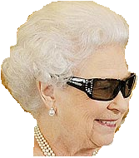
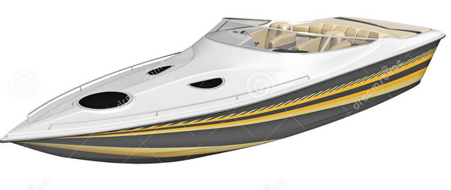
New Identities
From C2 you knew:
$$\sin^{2}{x}+\cos^{2}{x}=1$$
There are just two new identities you need to know:
Fro Tip: I used to misremember this as “$$1+\sec^{2}{x}=\tan^{2}{x}$$”.
Then I imagined the Queen coming back from holiday, saying “One is tanned”, i.e. the 1 goes with the $$\tan^{2}{x}.$$
Dividing by $$\cos^{2}{x}$$:
$$1+\tan^{2}{x}=\sec^{2}{x}$$
?
$$1+\cot^{2}{x}={cosec}^{2}{x}$$
Dividing by $$\sin^{2}{x}$$:
?
“Prove that $$1+\tan^{2}{x}≡\sec^{2}{x}$$.”
Fro Tip: I remember this one by starting with the above, and slapping ‘co’ on front of each trig function.
$$\sin^{2}{x}+\cos^{2}{x}≡1$$
$$\frac{\sin^{2}{x}}{\cos^{2}{x}}+\frac{\cos^{2}{x}}{\cos^{2}{x}}≡\frac{1}{\cos^{2}{x}}$$
$$\tan^{2}{x}+1≡\sec^{2}{x}$$
Fro Tip: This has been asked in an exam before! You must explicitly show each term being divided by $$\cos^{2}{x}$$.

Slide 22
Examples
[Textbook] Prove that $${cosec}^{4}{θ}−\cot^{4}{θ}=\frac{1+\cos^{2}{θ}}{1−\cos^{2}{x}}$$
?
$$LHS= \left({cosec}^{2}{θ}{+\cot^{2}{θ}}\right)\left({cosec}^{2}{θ}−\cot^{2}{θ}\right)$$$$={cosec}^{2}{θ}{+\cot^{2}{θ}}$$$$=\frac{1}{\sin^{2}{θ}}+\frac{\cos^{2}{θ}}{\sin^{2}{θ}}$$$$=\frac{1+\cos^{2}{θ}}{1−\cos^{2}{x}}=RHS$$
Solve the equation $$4 cosec^{2}θ−9=\cot{θ}$$ in the interval $$0≤θ≤360°$$
?
$$4\left(1+\cot^{2}{θ}\right)−9=\cot{θ}$$$$4\cot^{2}{θ}−\cot{θ}−5=0$$$$\left(4\cot{θ}−5\right)\left(\cot{θ}+1\right)=0$$$$∴\cot{θ}=\frac{5}{4} or\cot{θ}=−1$$$$\tan{θ}=\frac{4}{5} or\tan{θ}=−1$$$$θ=38.7°,135°, 218.7°,315°$$
This is just like in C2; if you had say a mixture of $$\sin{θ},\sin^{2}{θ},\cos^{2}{θ}$$: you’d change the $$\cos^{2}{θ}$$ to $$1−\sin^{2}{θ}$$ in order to get a quadratic in terms of $$sin$$.

Slide 23
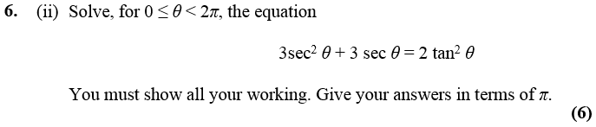
Test Your Understanding
Edexcel C3 June 2013 (R)
$$3\sec^{2}{θ}+3\sec{θ}=2\left(\sec^{2}{θ}−1\right)$$$$\sec^{2}{θ}+3\sec{θ}+2=0 →\left(\sec{θ}+2\right)\left(\sec{θ}+1\right)=0$$$$\frac{1}{\cos{θ}}=−2 → \cos{θ}=−\frac{1}{2} → θ=\frac{2π}{3},\frac{4π}{3}$$$$\frac{1}{\cos{θ}}=−1 → \cos{θ}=−1 → θ=π$$
?
Q
Solve, for $$0≤x<2π$$, the equation
$$2cosec^{2}x+\cot{x}=5$$
giving your solutions to 3sf.
$$2\left(1+\cot^{2}{x}\right)+\cot{x}−5=0$$$$2+2\cot^{2}{x}+\cot{x}−5=0$$$$2\cot^{2}{x}+\cot{x}−3=0$$$$\left(2\cot{x}+3\right)\left(\cot{x}−1\right)=0$$$$\cot{x}=−\frac{3}{2} or \cot{x}=1$$$$\tan{x}=−\frac{2}{3} or \tan{x}=1$$$$x=2.55, 5.70, 0.785, 3.93$$
?

Slide 24
Exercises 6D
Pearson Pure Mathematics Year 2/AS
Pages 156-157

Slide 25
Inverse Trig Functions
You need to know how to sketch $$y=\arcsin{x}, y=\arccos{x}$$, $$y=\arctan{x}$$.
(Yes, you could be asked in an exam!)
$$y$$
$$\frac{π}{2}$$
$$y=arcsin x$$
We have to restrict the domain of $$\sin{x}$$ to $$−\frac{π}{2}≤x<\frac{π}{2}$$ before we can find the inverse. Why?
Because only one-to-one functions have an inverse. By restricting the domain it is now one-to-one.
$$1$$
?
$$y=\sin{x}$$
$$x$$
$$−\frac{π}{2}$$
$$−1$$
$$1$$
$$\frac{π}{2}$$
$$−1$$
$$−\frac{π}{2}$$

Slide 26
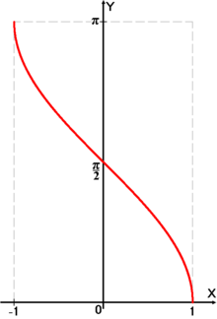
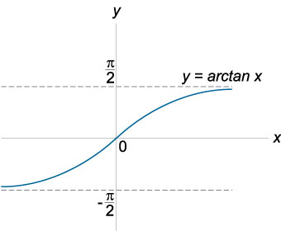
Inverse Trig Functions
$$y=\arccos{x}$$
$$y=\arctan{x}$$
?
?
Note that this graph has asymptotes.

Slide 27
Evaluating inverse trig functions
[Textbook] Work out, in radians, the values of:
arcsin−22
$$\arccos\left(−1\right)$$
arctan3
You can simply use the $$\sin^{−1}{x}$$, $$\cos^{−1}{x}$$ and $$\tan^{−1}{x}$$ buttons on your calculator.
If you don’t have a calculator, just use the $$sin,cos,tan$$ graphs backwards.
?
arcsin−22=−𝜋4$$\arccos\left(−1\right)=π$$arctan3=𝜋3
?
?

Slide 28
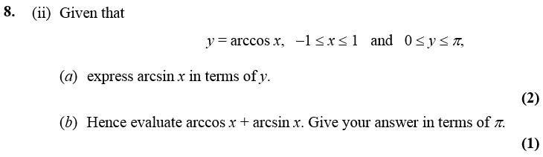
One Final Problem…
Edexcel C3 Jan 2007
$$y=\arccos{x}$$
$$x=\cos{y}=sin\left(\frac{π}{2}−y\right)$$
$$\arcsin{x=\frac{π}{2}−y}$$
$$\arccos{x+\arcsin{x}}$$
$$=y+\frac{π}{2}−y=\frac{π}{2}$$
Fewer than 10% of candidates got this part right.

Slide 29
Exercises 6E
Pearson Pure Mathematics Year 2/AS
Pages 160-161

